Slide 1
Presentation
CSE350
Section : 01
Presented By:
Sakibur Rahman - 2014-1-60-032
Riajul Islam - 2014-2-60-087
Md. Jihan - 2014-3-60-025
Course Instructor : Maheen Islam
Dept. of Computer Science and Engineering

Slide 2
Satellites
2

Slide 3
3
A satellite is an object in space
that orbits or circles around a
bigger object.

Slide 4
4
Two kinds of satellites
Natural
Moon orbiting the Earth
There are dozens upon dozens of natural satellites in the solar system, with almost every planet having at least one moon. Saturn, for example, has at least 53 natural satellites
Artificial
International Space Station orbiting the Earth

Slide 5
Natural Satellites?
5

Slide 6
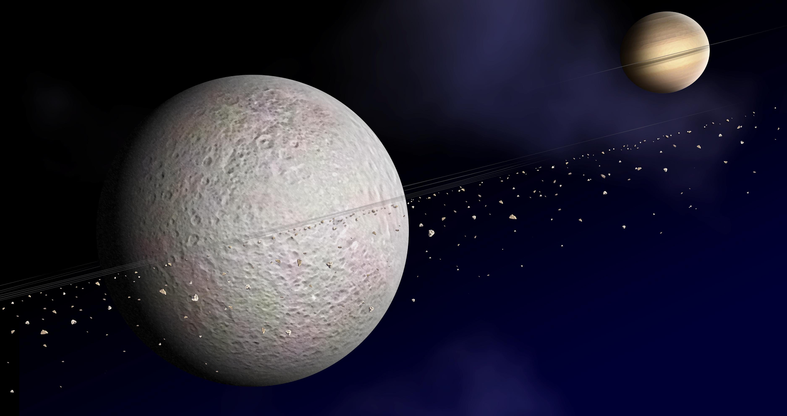
6

Slide 7
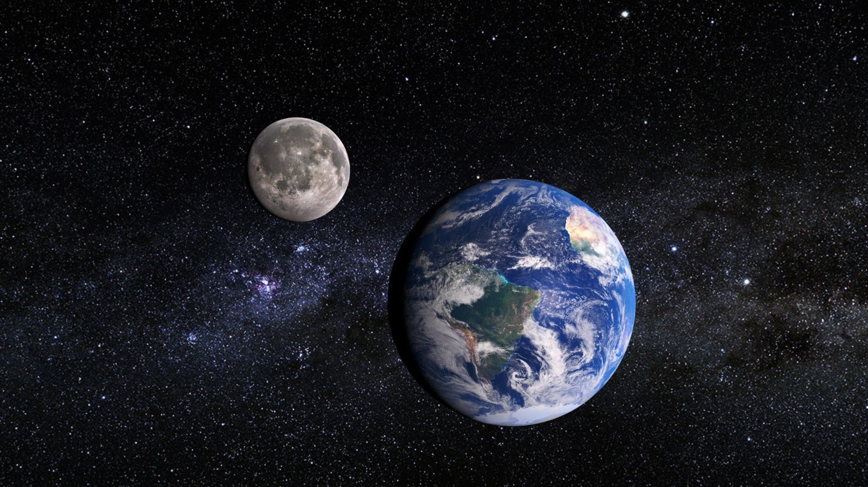
7

Slide 8
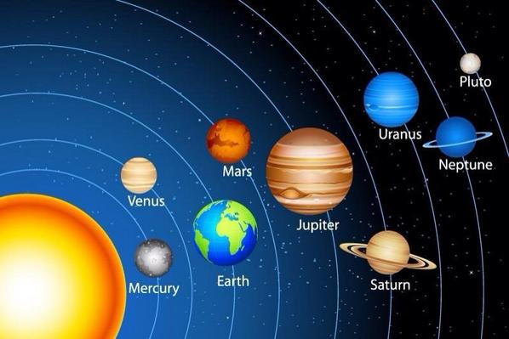
8

Slide 9
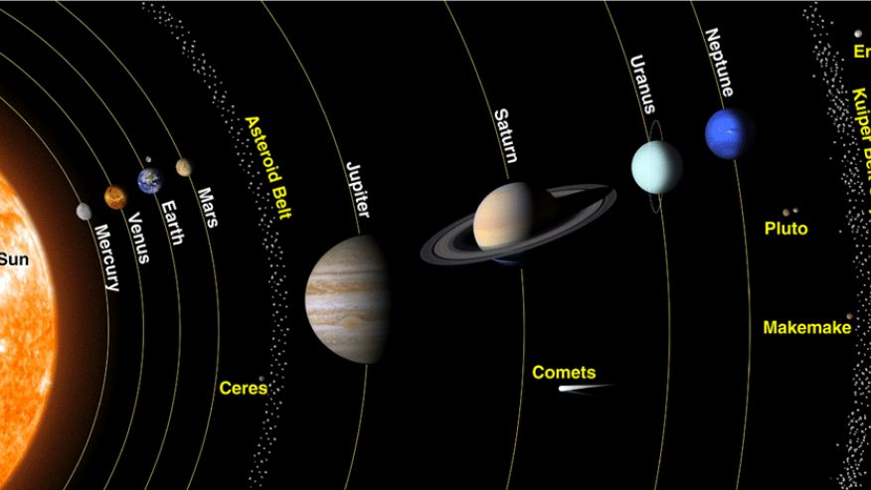
9

Slide 10
Artificial Satellites?
10

Slide 12
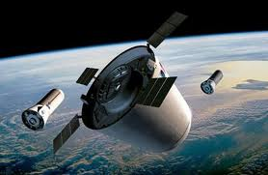
12

Slide 13
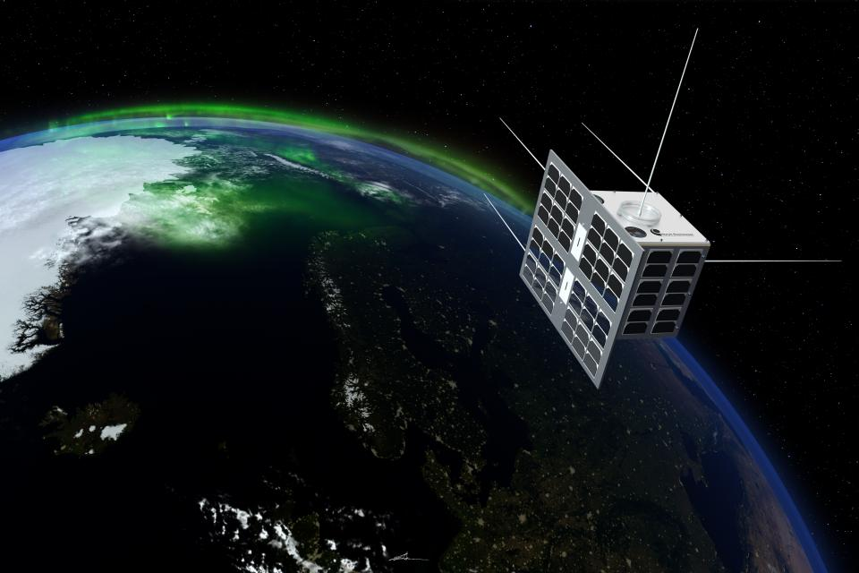
13

Slide 14
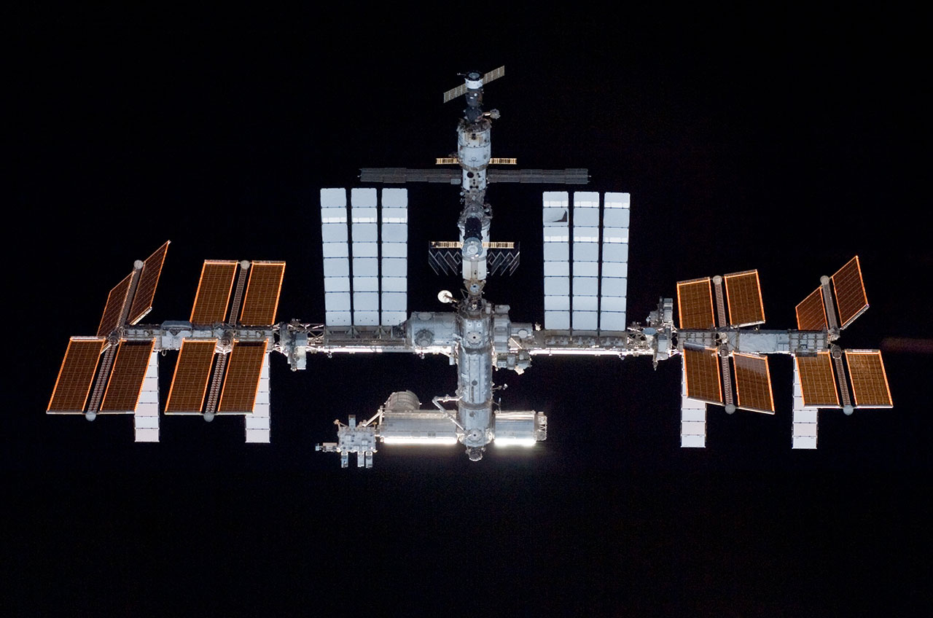
14
The International Space Station is the largest satellite in orbit. This file photo of the station was taken in May 2010 by NASA space shuttle astronauts. Credit: NASA

Slide 15
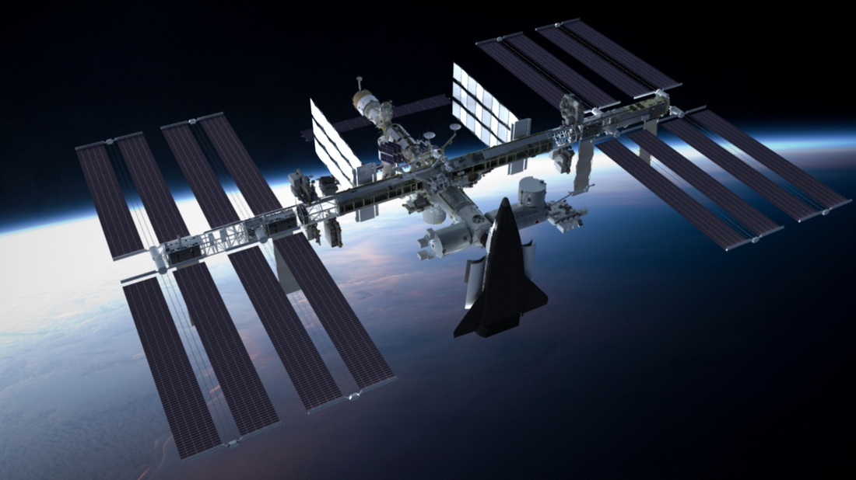
15

Slide 16
Artificial
Satellites
16
Our Goal

Slide 17
17
Akash

Slide 18
Artificial satellite
Invention
Story
18

Slide 19
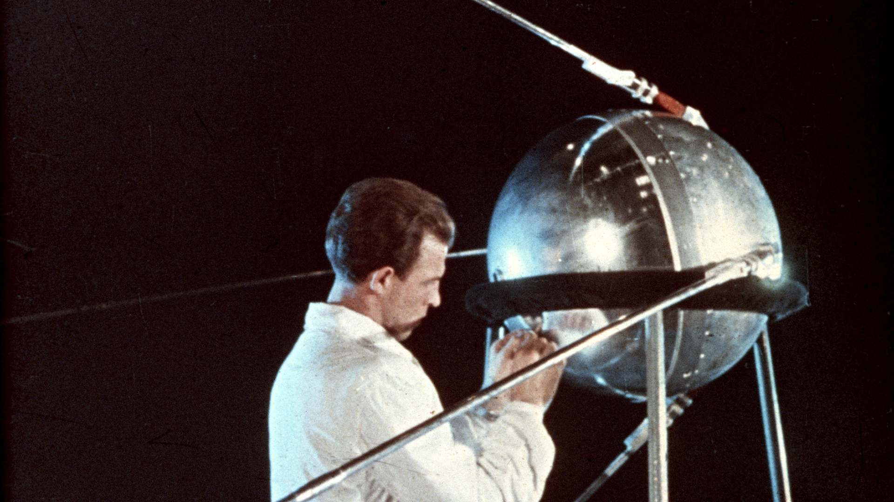
History changed on October 4, 1957, when the Soviet Union successfully launched Sputnik I. The world's first artificial satellite was about the size of a beach ball (58 cm.or 22.8 inches in diameter), weighed only 83.6 kg. or 183.9 pounds, and took about 98 minutes to orbit the Earth on its elliptical path.
19

Slide 20
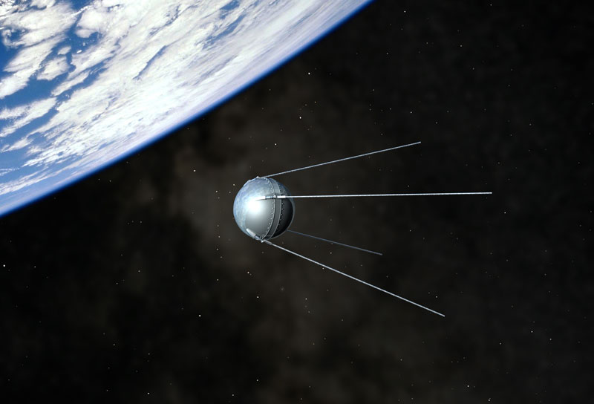
20

Slide 21
How satellite works...
21

Slide 22
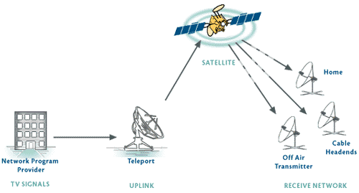
22

Slide 23
Types of Satellites
23

Slide 24
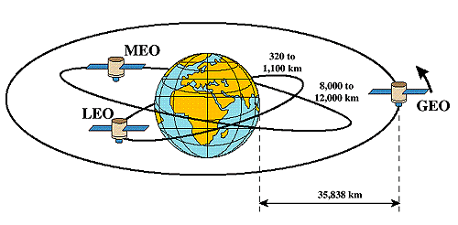
24

Slide 25
Already
We have seen...
25

Slide 26
Types, Installation and Operation
of Satellites
26

Slide 27
27
Sakib

Slide 28
28
Is it a satellite?

Slide 29
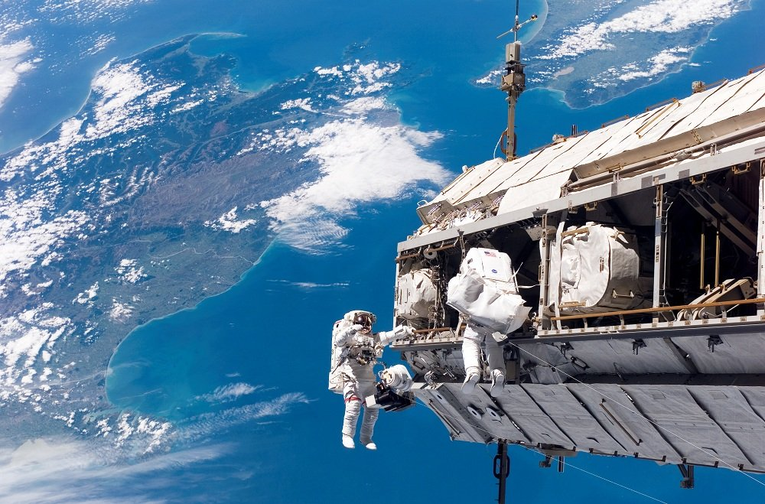
29

Slide 30
Yes !!!
30

Slide 31
No !!! !!!
31

Slide 32
Very good
32

Slide 33
33
Is it a satellite?

Slide 34
34

Slide 35
Wrong Answer: No
Right answer: Yes
35

Slide 36
36
Space Station

Slide 37
37

Slide 38
How Are Satellites Repaired In Space?
38

Slide 39
NASA astronauts Scott Kelly and Tim Kopra are performing an unexpected spacewalk, to fix a rail car that stalled on the outside of the International Space Station (Dec 21, 2015)
39

Slide 40
40
Akash

Slide 41
Satellite
Applications
41

Slide 42
Long distance transmission of
Television programmes
Telephones communication
Internet
42

Slide 43
Used for
Research
Defense
Remote sensing: collecting information from a distance
43

Slide 44
GPS: Global positioning system
Weather info collection
Agriculture
Land and ocean features including movement of fish in oceans
44

Slide 45
Simply saying,
Where not...
45

Slide 46
46
Sakib

Slide 47
47
Satellite
Business

Slide 48
In previous
We’ve seen ...
48

Slide 49
49

Slide 50
50
Now...

Slide 51
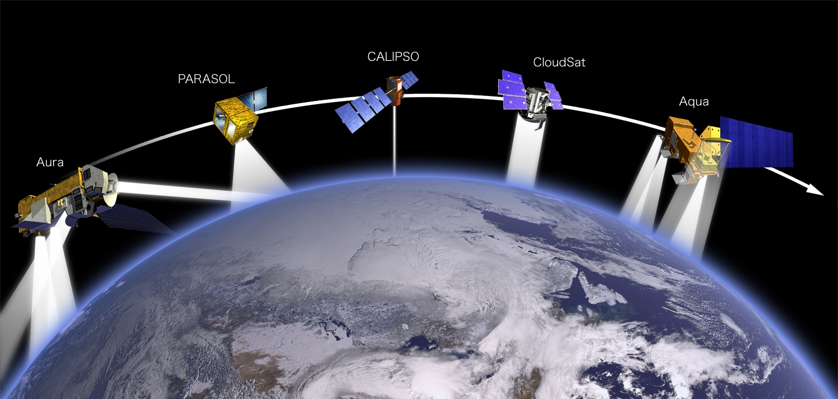
51

Slide 52
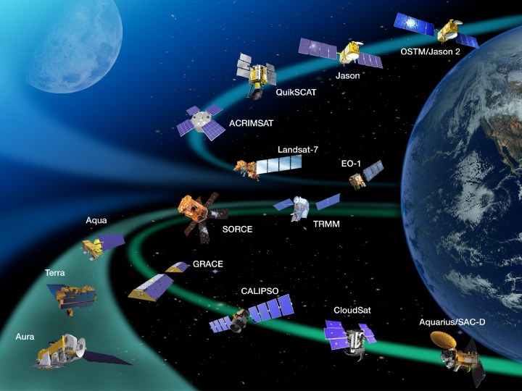
52

Slide 53
53
Too many Satellites

Slide 54
54
Multi billion $ business

Slide 55
Satellite being key to building
the future digital highways requires all players work together
striving for innovation
meeting market challenges
To solve problems
55

Slide 56
How business works...
56

Slide 57


Slide 58
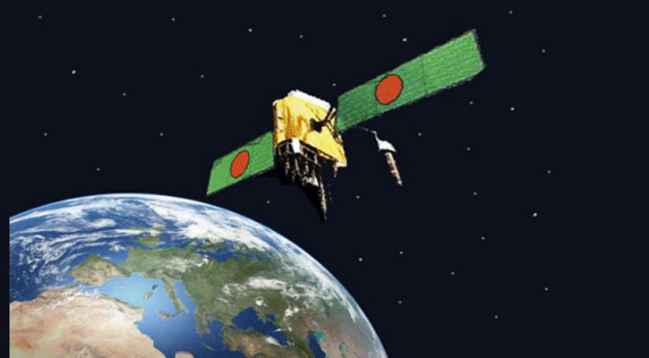

Slide 59
Could you please join with me…
To Team members...
58

Slide 60
Any Questions?
59

Slide 61
Thank you
60

